Slide 1
AN ANDROID APPLICATION FOR KEEPING UP WITH THE LATEST HEADLINES
DONE BY

Slide 2
To design and develop a dynamic and user-friendly Android application that serves as a comprehensive platform for accessing the latest news headlines in real-time. The app aims to provide users with categorized news updates across various domains, such as sports, technology, politics, and entertainment. By integrating features like keyword-based search, personalized bookmarks, push notifications for breaking news, offline reading capabilities, and multi-language support, the application seeks to enhance user engagement and ensure seamless access to information. Additionally, the inclusion of a modern, intuitive UI with dark mode options aims to deliver a comfortable and customizable reading experience for users, catering to diverse preferences and needs.
OBJECTIVE

Slide 3
CODE:
package com.example.newsheadlines import android.content.Context import android.content.Intent import android.os.Bundle import androidx.activity.ComponentActivity import androidx.activity.compose.setContent import androidx.compose.foundation.Image import androidx.compose.foundation.background import androidx.compose.foundation.layout.* import androidx.compose.foundation.shape.RoundedCornerShape import androidx.compose.material.* import androidx.compose.material.icons.Icons import androidx.compose.material.icons.filled.Email import androidx.compose.material.icons.filled.Lock import androidx.compose.material.icons.filled.Person import androidx.compose.runtime.* import androidx.compose.ui.Alignment

Slide 4
import androidx.compose.ui.Modifier import androidx.compose.ui.graphics.Color import androidx.compose.ui.res.painterResource import androidx.compose.ui.text.font.FontWeight import androidx.compose.ui.text.input.PasswordVisualTransformation import androidx.compose.ui.tooling.preview.Preview import androidx.compose.ui.unit.dp import androidx.compose.ui.unit.sp import androidx.core.content.ContextCompat import com.example.newsheadlines.ui.theme.NewsHeadlinesTheme

Slide 5
class RegistrationActivity : ComponentActivity() { private lateinit var databaseHelper: UserDatabaseHelper override fun onCreate(savedInstanceState: Bundle?) { super.onCreate(savedInstanceState) databaseHelper = UserDatabaseHelper(this) setContent { RegistrationScreen(this,databaseHelper) } } }

Slide 6
@Composable fun RegistrationScreen(context: Context, databaseHelper: UserDatabaseHelper) { var username by remember { mutableStateOf("") } var password by remember { mutableStateOf("") } var email by remember { mutableStateOf("") } var error by remember { mutableStateOf("") } Column( Modifier .background(Color.White) .fillMaxHeight() .fillMaxWidth(), horizontalAlignment = Alignment.CenterHorizontally, verticalArrangement = Arrangement.Center)

Slide 7
{ Row { Text( text = "Sign Up", color = Color(0xFF6495ED), fontWeight = FontWeight.Bold, fontSize = 24.sp, style = MaterialTheme.typography.h1 ) Divider( color = Color.LightGray, thickness = 2.dp, modifier = Modifier .width(250.dp) .padding(top = 20.dp, start = 10.dp, end = 70.dp) ) }

Slide 8
Image( painter = painterResource(id = R.drawable.sign_up), contentDescription = "", modifier = Modifier.height(270.dp) ) TextField( value = username, onValueChange = { username = it }, leadingIcon = { Icon( imageVector = Icons.Default.Person, contentDescription = "personIcon", tint = Color(0xFF6495ED) ) },

Slide 9
placeholder = { Text( text = "username", color = Color.Black ) }, colors = TextFieldDefaults.textFieldColors( backgroundColor = Color.Transparent ) ) Spacer(modifier = Modifier.height(8.dp)) TextField( value = password, onValueChange = { password = it }, leadingIcon = { Icon( imageVector = Icons.Default.Lock, contentDescription = "lockIcon", tint = Color(0xFF6495ED) ) },

Slide 10
placeholder = { Text(text = "password", color = Color.Black) }, visualTransformation = PasswordVisualTransformation(), colors = TextFieldDefaults.textFieldColors(backgroundColor = Color.Transparent) ) Spacer(modifier = Modifier.height(16.dp)) TextField( value = email, onValueChange = { email = it }, leadingIcon = { Icon( imageVector = Icons.Default.Email, contentDescription = "emailIcon", tint = Color(0xFF6495ED) ) }, placeholder = { Text(text = "email", color = Color.Black) }, colors = TextFieldDefaults.textFieldColors(backgroundColor = Color.Transparent) )

Slide 11
Spacer(modifier = Modifier.height(8.dp)) if (error.isNotEmpty()) { Text( text = error, color = MaterialTheme.colors.error, modifier = Modifier.padding(vertical = 16.dp) ) } Button( onClick = { if (username.isNotEmpty() && password.isNotEmpty() && email.isNotEmpty()) { val user = User( id = null, firstName = username, lastName = null, email = email, password = password ) databaseHelper.insertUser(user) error = "User registered successfully" // Start LoginActivity using the current context context.startActivity( Intent( context, LoginActivity::class.java ) )

Slide 12
} else { error = "Please fill all fields" } }, shape = RoundedCornerShape(20.dp), colors = ButtonDefaults.buttonColors(backgroundColor = Color(0xFF77a2ef)), modifier = Modifier.width(200.dp) .padding(top = 16.dp) ) { Text(text = "Register", fontWeight = FontWeight.Bold) } Row( modifier = Modifier.padding(30.dp), verticalAlignment = Alignment.CenterVertically, horizontalArrangement = Arrangement.Center ) { Text(text = "Have an account?")

Slide 13
TextButton(onClick = { context.startActivity( Intent( context, LoginActivity::class.java ) ) }) { Text(text = "Log in", fontWeight = FontWeight.Bold, style = MaterialTheme.typography.subtitle1, color = Color(0xFF4285F4) )} } } } private fun startLoginActivity(context: Context) { val intent = Intent(context, LoginActivity::class.java) ContextCompat.startActivity(context, intent, null) }

Slide 14
LOGIN ACTIVITY
package com.example.newsheadlines import android.content.Context import android.content.Intent import android.os.Bundle import androidx.activity.ComponentActivity import androidx.activity.compose.setContent import androidx.compose.foundation.Image import androidx.compose.foundation.background import androidx.compose.foundation.layout.* import androidx.compose.foundation.shape.RoundedCornerShape import androidx.compose.material.* import androidx.compose.material.icons.Icons import androidx.compose.material.icons.filled.Lock import androidx.compose.material.icons.filled.Person import androidx.compose.runtime.* import androidx.compose.ui.Alignment import androidx.compose.ui.Modifier

Slide 15
import androidx.compose.ui.graphics.Color import androidx.compose.ui.res.painterResource import androidx.compose.ui.text.font.FontWeight import androidx.compose.ui.text.input.PasswordVisualTransformation import androidx.compose.ui.tooling.preview.Preview import androidx.compose.ui.unit.dp import androidx.compose.ui.unit.sp import androidx.core.content.ContextCompat import androidx.core.content.ContextCompat.startActivity import com.example.newsheadlines.ui.theme.NewsHeadlinesTheme

Slide 16
class LoginActivity : ComponentActivity() { private lateinit var databaseHelper: UserDatabaseHelper override fun onCreate(savedInstanceState: Bundle?) { super.onCreate(savedInstanceState) databaseHelper = UserDatabaseHelper(this) setContent { LoginScreen(this, databaseHelper) } } } @Composable fun LoginScreen(context: Context, databaseHelper: UserDatabaseHelper) { var username by remember { mutableStateOf("") } var password by remember { mutableStateOf("") } var error by remember { mutableStateOf("") }

Slide 17
Column( Modifier .fillMaxHeight() .fillMaxWidth() .padding(28.dp), horizontalAlignment = Alignment.CenterHorizontally, verticalArrangement = Arrangement.Center) { Image( painter = painterResource(id = R.drawable.news), contentDescription = "") Spacer(modifier = Modifier.height(10.dp)) Row { Divider(color = Color.LightGray, thickness = 2.dp, modifier = Modifier .width(155.dp) .padding(top = 20.dp, end = 20.dp)) Text(text = "Login", color = Color(0xFF6495ED),

Slide 18
fontWeight = FontWeight.Bold, fontSize = 24.sp,style = MaterialTheme.typography.h1) Divider(color = Color.LightGray, thickness = 2.dp, modifier = Modifier .width(155.dp) .padding(top = 20.dp, start = 20.dp)) } Spacer(modifier = Modifier.height(10.dp)) TextField( value = username, onValueChange = { username = it }, leadingIcon = { Icon( imageVector = Icons.Default.Person, contentDescription = "personIcon", tint = Color(0xFF6495ED) ) }, placeholder = { Text( text = "username", color = Color.Black ) }, colors = TextFieldDefaults.textFieldColors( backgroundColor = Color.Transparent )

Slide 19
) Spacer(modifier = Modifier.height(20.dp)) TextField( value = password, onValueChange = { password = it }, leadingIcon = { Icon( imageVector = Icons.Default.Lock, contentDescription = "lockIcon", tint = Color(0xFF6495ED) ) }, placeholder = { Text(text = "password", color = Color.Black) }, visualTransformation = PasswordVisualTransformation(), colors = TextFieldDefaults.textFieldColors(backgroundColor = Color.Transparent) ) Spacer(modifier = Modifier.height(12.dp)) if (error.isNotEmpty()) { Text( text = error, color = MaterialTheme.colors.error, modifier = Modifier.padding(vertical = 16.dp) )

Slide 20
} Button( onClick = { if (username.isNotEmpty() && password.isNotEmpty()) { val user = databaseHelper.getUserByUsername(username) if (user != null && user.password == password) { error = "Successfully log in" context.startActivity( Intent( context, MainPage::class.java ) ) //onLoginSuccess() } else { error = "Invalid username or password" } } else { error = "Please fill all fields" } }, shape = RoundedCornerShape(20.dp), colors = ButtonDefaults.buttonColors(backgroundColor = Color(0xFF77a2ef)), modifier = Modifier.width(200.dp)

Slide 21
.padding(top = 16.dp) ) { Text(text = "Log In", fontWeight = FontWeight.Bold) } Row(modifier = Modifier.fillMaxWidth()) { TextButton(onClick = { context.startActivity( Intent( context, RegistrationActivity::class.java ))}) { Text(text = "Sign up", color = Color.Black )} Spacer(modifier = Modifier.width(100.dp)) TextButton(onClick = { /* Do something! */ }) { Text(text = "Forgot password ?", color = Color.Black )} }

Slide 22
} } private fun startMainPage(context: Context) { val intent = Intent(context, MainPage::class.java) ContextCompat.startActivity(context, intent, null) }

Slide 23
DISPLAY
package com.example.newsheadlines import android.content.Intent import android.os.Bundle import android.util.Log import android.widget.TextView import androidx.activity.ComponentActivity import androidx.activity.compose.setContent import androidx.compose.foundation.Image import androidx.compose.foundation.background import androidx.compose.foundation.layout.Arrangement import androidx.compose.foundation.layout.Column import androidx.compose.foundation.layout.fillMaxSize import androidx.compose.foundation.layout.padding import androidx.compose.material.MaterialTheme import androidx.compose.material.Surface import androidx.compose.material.Text import androidx.compose.runtime.Composable

Slide 24
import androidx.compose.ui.Alignment import androidx.compose.ui.Modifier import androidx.compose.ui.graphics.Color import androidx.compose.ui.tooling.preview.Preview import androidx.compose.ui.unit.dp import androidx.compose.ui.unit.sp import androidx.compose.ui.viewinterop.AndroidView import androidx.core.text.HtmlCompat import coil.compose.rememberImagePainter import com.example.newsheadlines.ui.theme.NewsHeadlinesTheme

Slide 25
class DisplayNews : ComponentActivity() { override fun onCreate(savedInstanceState: Bundle?) { super.onCreate(savedInstanceState) setContent { NewsHeadlinesTheme { // A surface container using the 'background' color from the theme Surface( modifier = Modifier.fillMaxSize(), color = MaterialTheme.colors.background ) { var desk = getIntent().getStringExtra("desk") var title = getIntent().getStringExtra("title") var uriImage = getIntent().getStringExtra("urlToImage") Log.i("test123abc", "MovieItem: $desk")

Slide 26
Column(Modifier.background(Color.Gray).padding(20.dp), horizontalAlignment = Alignment.CenterHorizontally, verticalArrangement = Arrangement.Center) { Text(text = ""+title, fontSize = 32.sp) HtmlText(html = desk.toString()) /* AsyncImage( model = "https://example.com/image.jpg", contentDescription = "Translated description of what the image contains" )*/ Image( painter = rememberImagePainter(uriImage), contentDescription = "My content description", ) } // Greeting(desk.toString()) } } } } }

Slide 27
@Composable fun Greeting(name: String) { // Text(text = "Hello $name!") } @Preview(showBackground = true) @Composable fun DefaultPreview() { NewsHeadlinesTheme { // Greeting("Android") } } @Composable fun HtmlText(html: String, modifier: Modifier = Modifier) { AndroidView( modifier = modifier, factory = { context -> TextView(context) }, update = { it.text = HtmlCompat.fromHtml(html, HtmlCompat.FROM_HTML_MODE_COMPACT) } ) }

Slide 28
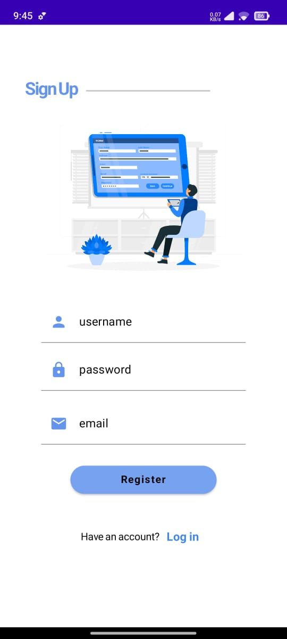
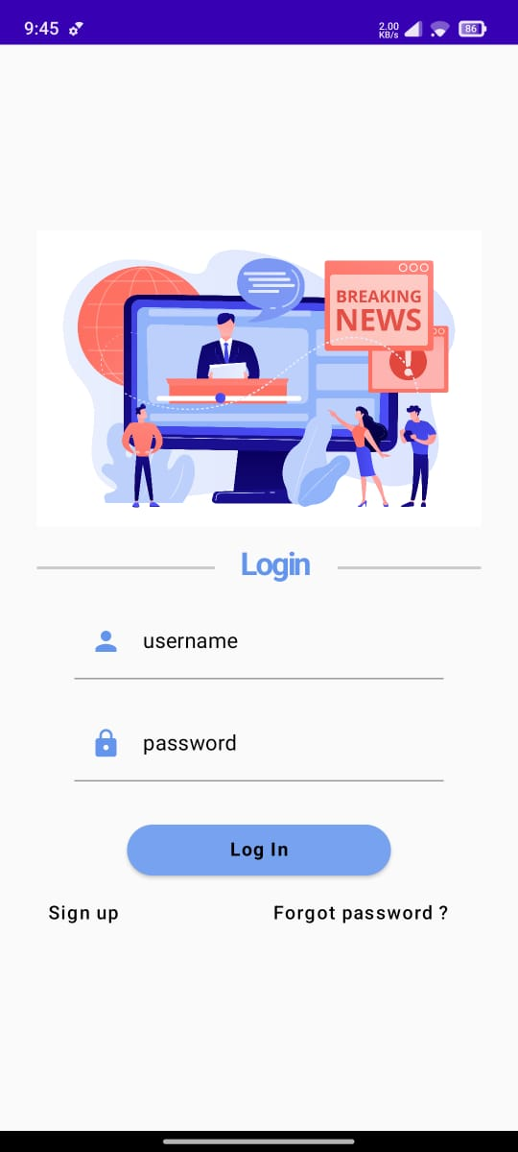
OUTPUT

Slide 29
